Slide 1





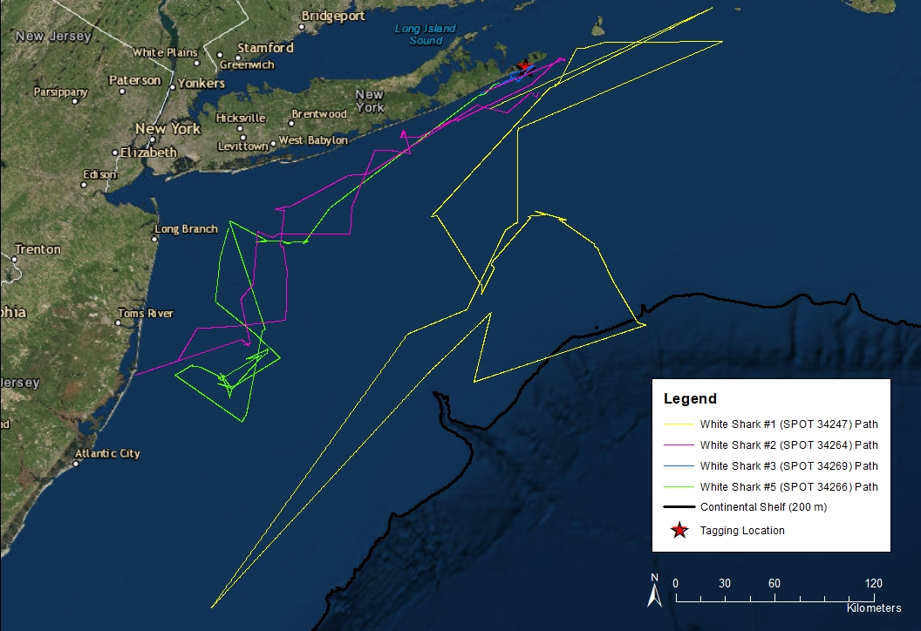
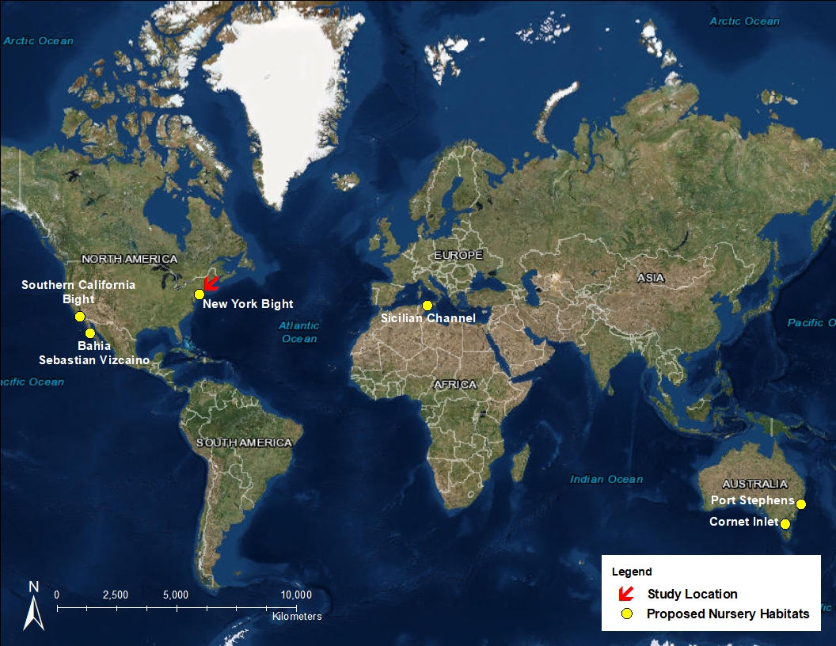
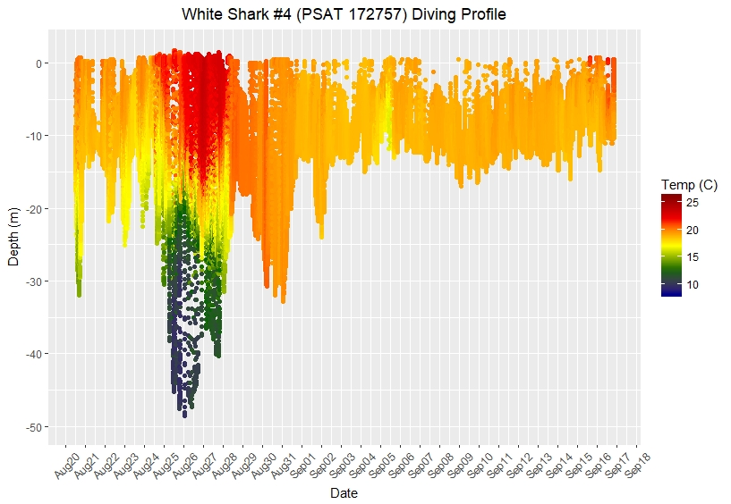
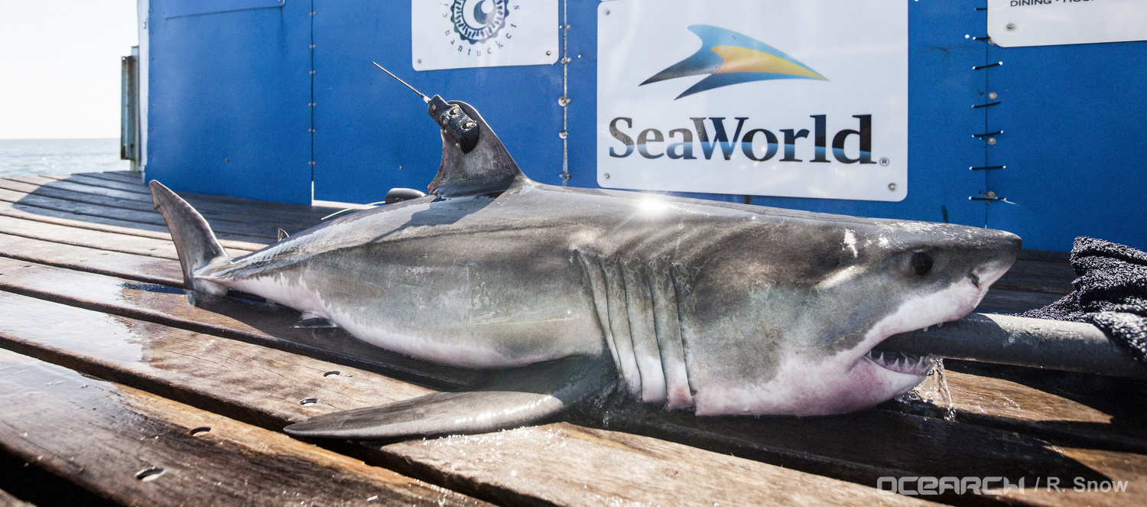
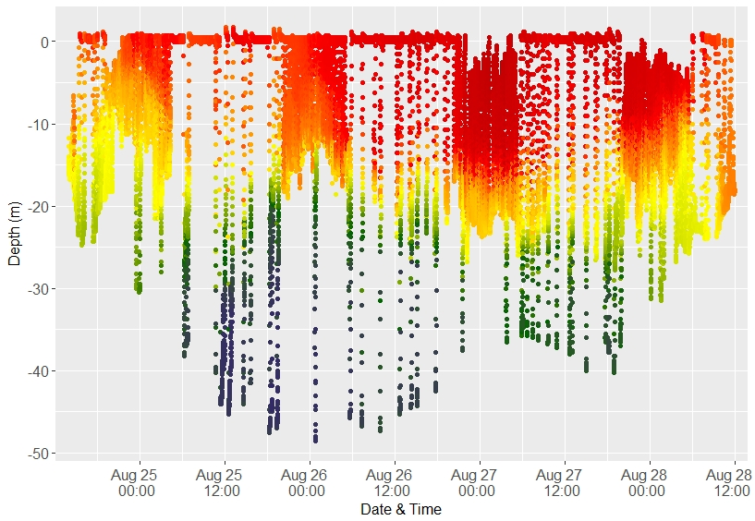
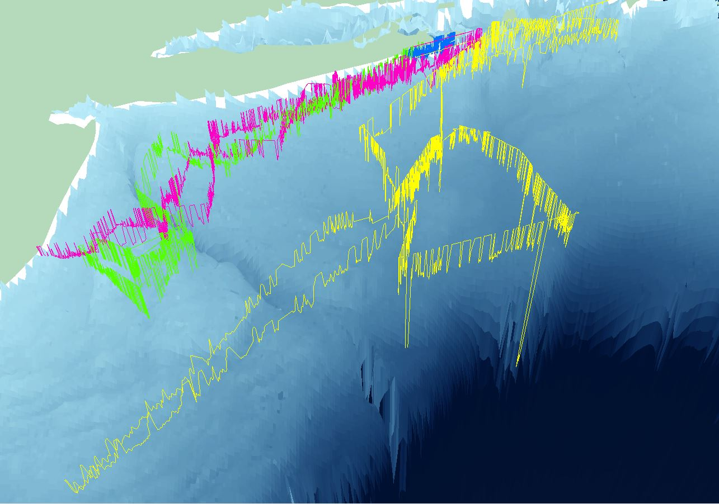
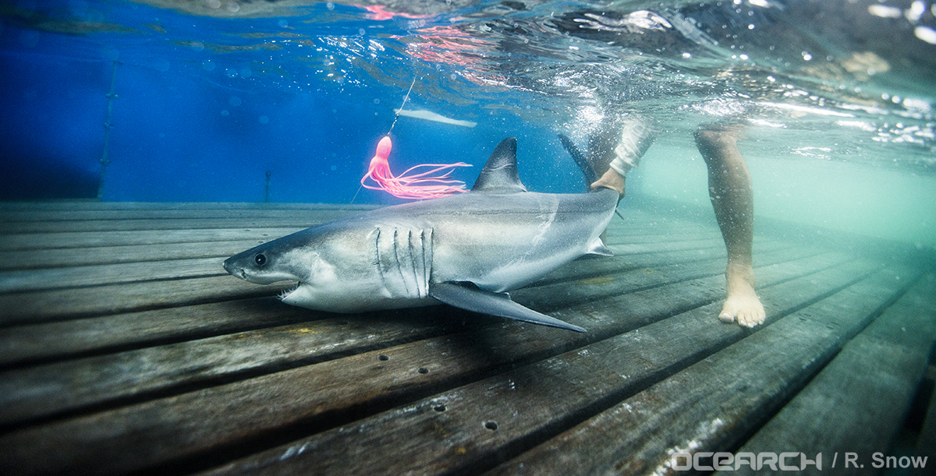
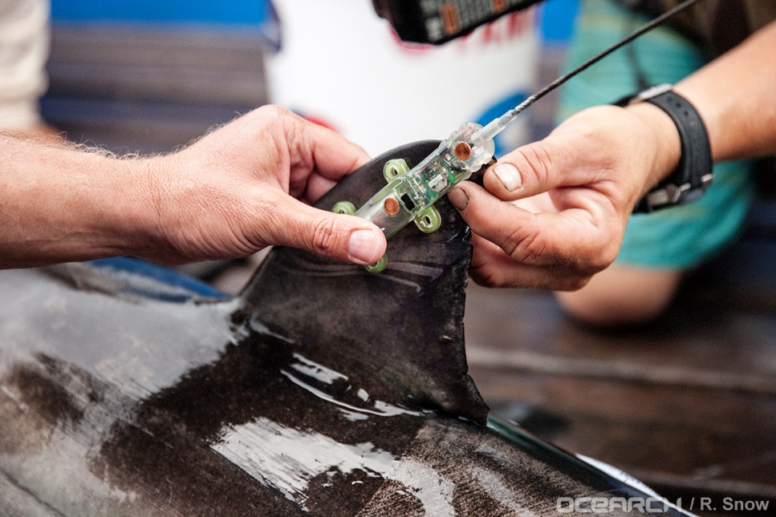
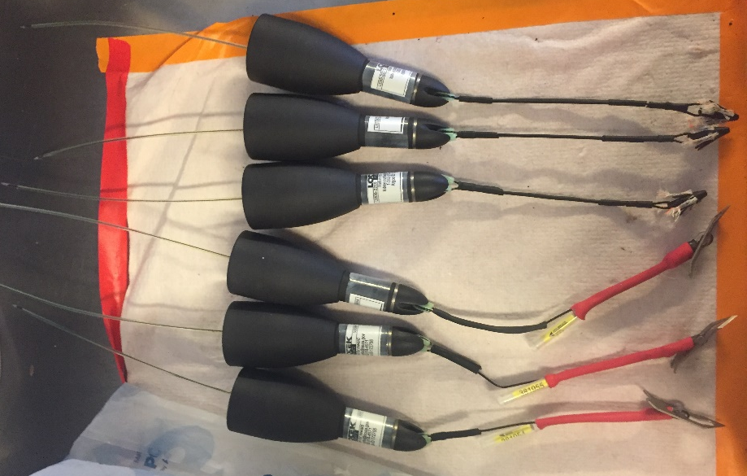
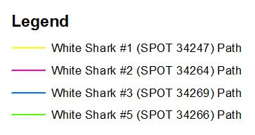




3D Movement and Habitat Use of Young-of-the-Year White Sharks in the Northwest Atlantic Ocean Rachel Shaw¹, Tobey Curtis², Gregory Metzger³, Michael McCallister¹, Christopher Fischer⁴, and Matthew Ajemian¹ ¹Florida Atlantic University, Harbor Branch Oceanographic Institute, Fort Pierce, FL, USA, ²NOAA National Marine Fisheries Service, Atlantic Highly Migratory Species Management Division, Gloucester, MA, USA, ³South Fork Natural History Museum, Bridgehampton, NY, USA, ⁴OCEARCH, Park City, UT, USA
INTRODUCTION
PRELIMINARY RESULTS
DISCUSSION
While white sharks (Carcharodon carcharias) are well-known apex predators, there are critical knowledge gaps on the movement patterns and habitat use of the young-of-the-year (YOY) life stage, particularly in the Northwest Atlantic. Understanding the movements and habitat of this vulnerable life stage is important for informing fisheries management and conservation strategies.
White sharks are prohibited species in U.S. waters due to their inherent biological vulnerability and evidence of historic population decline. White shark populations are susceptible to decline and slow to recover from depletion due to:
K-selected life history strategies (CITES 2004)
Highly migratory behavior, including movements across international boundaries (Skomal et al 2017; Jorgensen et al 2010)
Exposure to anthropogenic influences (Curtis et al 2014, 2018; Bruce 2008):
Bycatch in trawl, longline, gillnet, and rod-and-reel fisheries
Habitat degradation
Unregulated international waters
Nearshore nursery locations
Horizontal movements show tendency for YOY white sharks to remain in New York Bight during the months of August and September 2017
Diving profiles and 3D modeling show YOY white sharks remained:
Over continental shelf waters swimming regularly between the surface and 9 m (±6 m) in depth
Over bottom depths ranging from 7 m to 410 m
Figure 4: SPOT tags identified a majority of horizontal movements parallel to Long Island’s southern shoreline. Movements extended between 0.68 km and 185 km from shore, with individuals traveling total distances between 50 km and 1243 km over a course of 25 to 28 days. **White Shark #4 not shown as horizontal transmissions were not received from SPOT tag.
Table 2: PSAT logs show individuals spent time in temperatures ranging between 7.94°C and 24.70°C, with the most time spent in water temperatures of 19°C (±1°C).
PSAT logs also indicate individuals spent considerable time between the surface and depths of 9 m (±6 m). Vertical oscillations as deep as 200 m were observed.
Descriptive Statistics | Temp (°C) | Depth (m)
Mean | 19.25 | -9.08
Standard Deviation | 1.16 | 5.74
Range | 16.76 | 199.38
Minimum | 7.94 | -199.38
Maximum | 24.70 | 0.00
Count (n=5 individuals) | 493,271 | 493,271
Figure 7: Colored bands indicate mean swimming depth of each individual. Individuals swam in average water depths of 18 m to 77 m, and generally used the top portions of the water column. However, White Shark #3 swam most frequently in the middle of the water column.
This behavior may influence YOY white shark susceptibility to certain gear types (i.e. rod & reel vs bottom trawl)
These results will help improve characterization of essential fish habitat used by white sharks at the YOY stage and provide data that can be used by fisheries management to best manage this species
Figure 1: White shark nursery habitats worldwide
(Onate-Gonzalez et al 2017)
RESEARCH OBJECTIVES
To create a 3-dimensional model describing the movement patterns of YOY white sharks in the New York Bight in order to:
Characterize temperature and depth use
Calculate frequency of interaction with benthos
Investigate potential diel patterns
Figure 8: White Shark #3 before releasing
FUTURE DIRECTIONS
MATERIALS AND METHODS
Tag additional YOY white sharks with combinations of satellite tags
Calculate 95% and 50% kernel utilization distribution (activity space) per individual
Quantify individual variation in vertical activity and habitat
Investigate the diel patterns in relation to the diving behavior of individuals
Improve PSAT-derived geolocation and movement models
YOY white sharks were dual-fitted with:
Pop-off Satellite Archival Tags (PSAT): Lotek PSATLIFE
Smart Position or Temperature transmitting (SPOT) tags: Wildlife Computers SPOT6
Location: New York Bight off Montauk, New York
Study Duration: August to September 2017
Sample Size: 5 individuals: 3 ♂, 2 ♀ (147-167cm TL)
Data analyzed using ArcMap, ArcScene, and R Studio.
Figure 5: Diving profile illustrates vertical oscillations by white shark #4 as deep as 50 m. The temperature range found in these deeper dives indicate possible interactions with an oceanographic feature (i.e. warm core ring) or a bathymetric feature (i.e. canyon).
Individual | Sex | Total Length (cm) | PSAT Attachment Type | Date of Capture | Duration (days)
White Shark #1 | M | 166.4 | SS Dart | 8/12/17 | 26
White Shark #2 | M | 165 | Domeier | 8/14/17 | 27
White Shark #3 | M | 147 | SS Dart | 8/17/17 | 26
White Shark #4 | F | 165 | SS Dart | 8/20/17 | **28
White Shark #5 | F | 165.4 | Domeier | 8/20/17 | 25
Figure 9: White shark caught on line during OCEARCH expedition
Table 1: Biological and tagging information. **Only received PSAT data; no transmissions from SPOT tag.
ACKNOWLEDGEMENTS
We would like to thank the National Oceanic and Atmospheric Administration, South Fork Natural History Museum, OCEARCH, Florida Atlantic University Harbor Branch Oceanographic Institute, Lotek Wireless, Florida Atlantic University Graduate Professional Student Association (GPSA), Harbor Branch Foundation, and the Fisheries Ecology and Conservation Lab (B. DeGroot, G. Roskar, C. Luck, S. Lombardo).
Figure 6: Three-dimensional modeling of the diving behavior and interpolated horizontal movement demonstrates individual’s interaction with bathymetry. Individuals swam over bottom depths of 7 m to 410 m on the continental shelf and slope. White Shark #1’s deepest dive to 200m took place on the continental slope (orange box), while White Shark #5 utilized the Hudson Canyon at a depth of 77 m (red box).
Figure 2: SPOT tag attached to first dorsal fin
Figure 3: PSATs with Domeier attachment (top), stainless steel dart tag (bottom)

